Slide 1




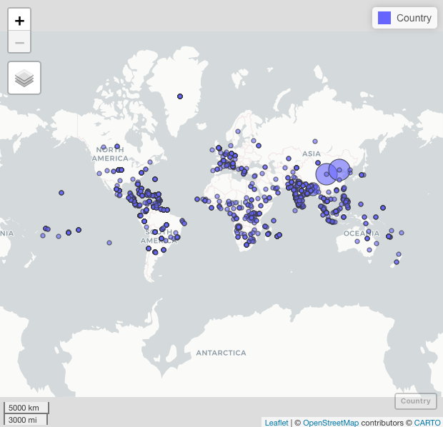
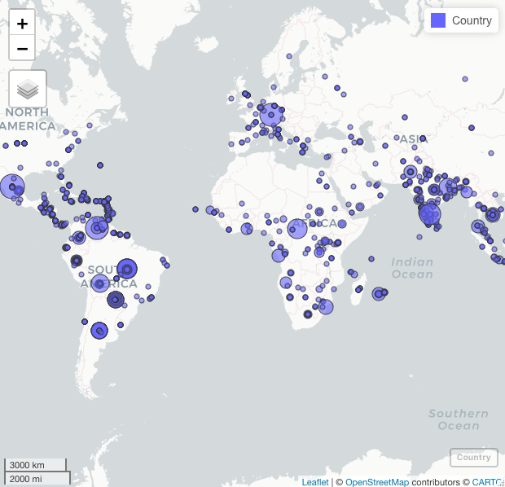
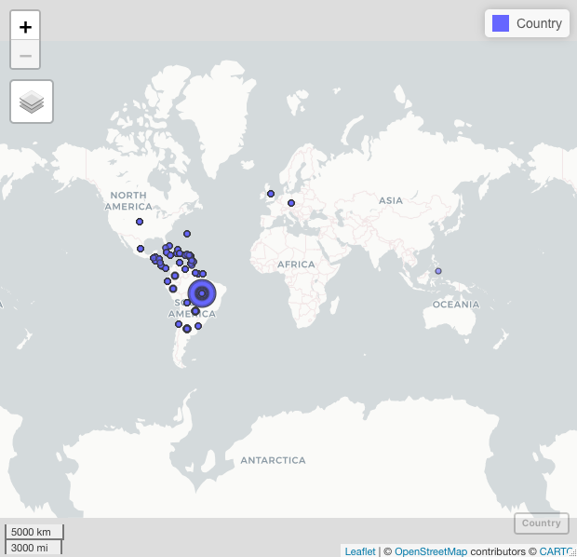
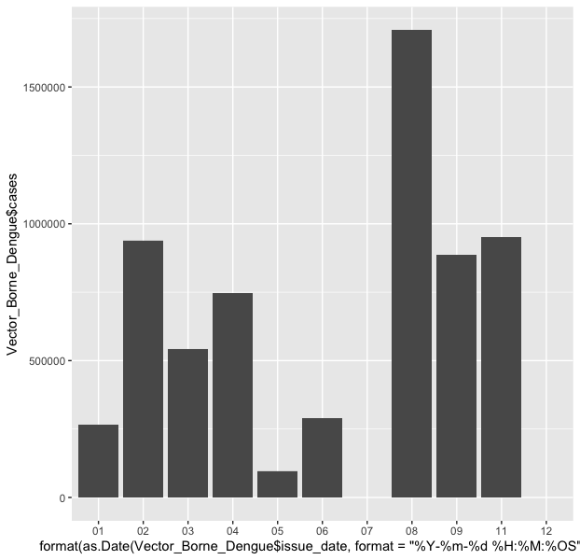
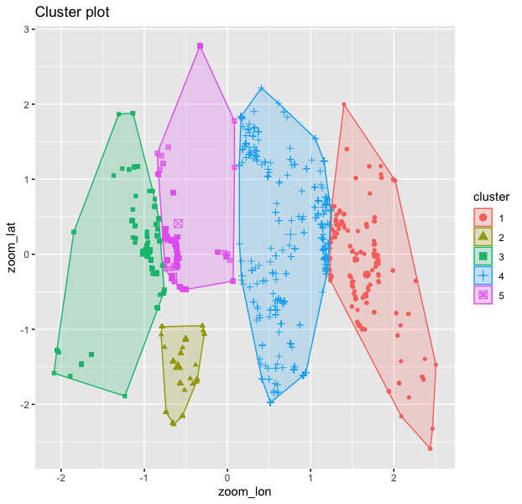
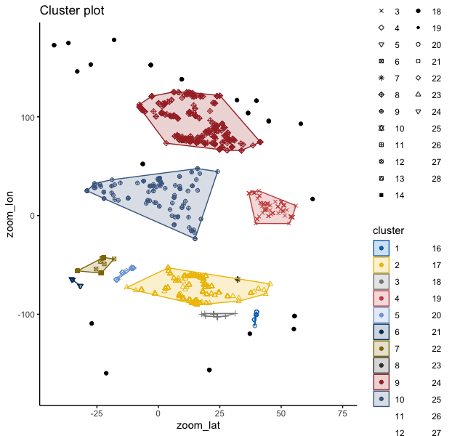

Dengue disease outbreak: Due to Extreme Precipitation
Sindhoora Mandadi and mandas@rpi.edu
¹Rensselaer Polytechnic Institute, Tetherless World Constellation, Troy, NY, United States,
Advisor Thillaka Munassinghe
Abstract
Exploratory Data Analysis
Climatic changes can have a dominant effect on the health of each individual. Changes in the environment like high precipitation value and land temperatures directly affect health care. If the precipitation value is higher there are chances of disease outbreak such as Dengue, Chikungunya and many diseases caused by vectors. Extreme climate and weather changes are the causes for droughts, floods and heat waves. These are favorable climatic conditions for Mosquitoes to breed which causes diseases like Dengue or Chikungunya. We are exploring the areas where the disease outbreak is highest and analyzing the precipitation values in that particular area.
Health care facilities play a very important role during this disease outbreak. We can't stop or eradicate the disease completely at once, but we can at least have some preventive measures and prepare for ourselves and health care facilities with necessary equipment for the treatment. For predicting the future outbreak to take preventive measures we are using the past data for the disease outbreak and the climate variables data. In recent times we all know about Floods in Florida the rising temperature and drastic climatic changes are causing these things for which we are focusing on the diseases caused by Mosquitoes due the drastic climatic changes.
Figure 1 Vector borne cases across all countries
Figure 2 Vector borne cases after filtering out the outliers
The Data
NASA GPM IMERG Monthly Precipitation Data
ProMed data from NASA Oakridge Labs Outbreak data
Figure 3 Dengue outbreak across different parts of the world
Figure 4 Month wise distribution of cases across different countries
Data Flow
Import
Import GPM data from NASA GPM
This data will be in the HDF file format
Inspect
Smoothing, Removing null values
Process
Deal with the problems in datasets
Save the dataset
Manipulate data
Disease outbreak data from Promed.
Remove Outliers
Import data into R
Figure 6 Clusters formed after applying K Means
Figure 7 Clustering based on DB Scan algorithm
Conclusion
Models worked well after applying different algorithms, we can conclude by cluster models and regression models. By looking into cluster model we can conclude that in South America the cases are high. In the future we can predict the cases using the precipitation values. The decision tree helps us understand the cases which have the greater precipitation values. By looking into the monthly plot we can conclude that the cases are more in the month of August which is the Rainy season in most parts of the world where the chances of Mosquitoes breeding increase and the disease outbreak may increase in this period of the year. We can conclude that in future we can expect the disease outbreak may occur in this period of the year.
Sponsors:
Glossary:
R – A program to process data and perform statistical analysis
Package (P) or Library (R): software package to be loaded to perform extra tasks
Levels in R dataframe – for factor data, the possible number of choices are levels
Resources:
ScrapeR Package in R: https://cran.r-project.org/web/packages/scrapeR/scrapeR.pdf
Read excel files in R: https://www.datacamp.com/community/tutorials/r-tutorial-read-excel-into-r
R deal with missing data: https://www.statmethods.net/input/missingdata.html
R visualization: https://www.analyticsvidhya.com/blog/2015/07/guide-data-visualization-r/

